Slide 1
Analytical CRM Development for a Bank
Created by Hari Prasad

Slide 2
Agenda
key performance indicator(KPI’s) review
The trend of customer exits over time review
Top 3 common characteristics among exited customers review, key points and suggestions
Critical/important churn rates of different kind of customers review, key points and suggestions
Meeting conclusion

Slide 3





key performance indicator(KPI’s)

Slide 4
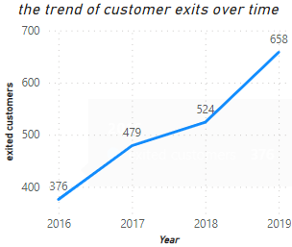
the trend of customer exits over time

Slide 5
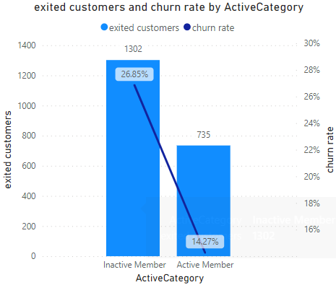
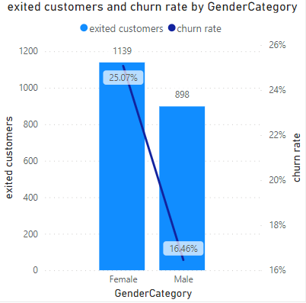
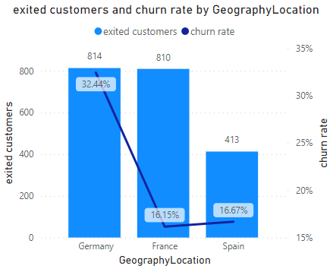
Top 3 common characteristics among exited customers

Slide 6
Key points
Those top 3 common characteristics is based on positive correlation between exited customers and churn rates.
Inactive members/customers : with 26.85% churn rate among Inactive members which resulted 1302 number of customers to exit.
Female customers : with 25.07% churn rate among Female customers which resulted 1139 number of customers to exit.
Germany region : with 32.44% churn rate in Germany region which resulted 814 number of customers to exit.

Slide 7
Suggestions
For making inactive members to active members we can introduce new services where can they interact, new consumable products for daily usage and new beneficial activities for encouraging them to particate more.
For female customers we can introduce selfcare, fashion and beauty products to retain them.
For Germany region we need do detailed analysis why customers are leaving the bank greater rate than other regions and need to find root cause ASAP for resolving and retaining .

Slide 8
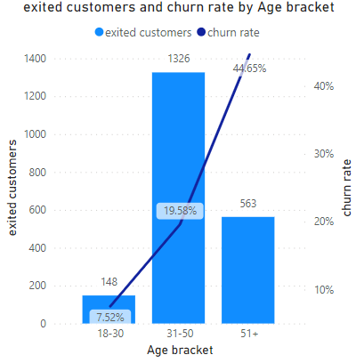
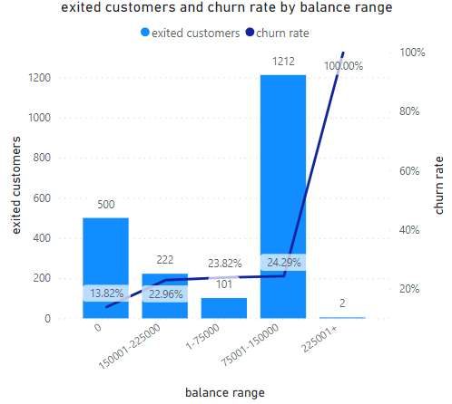
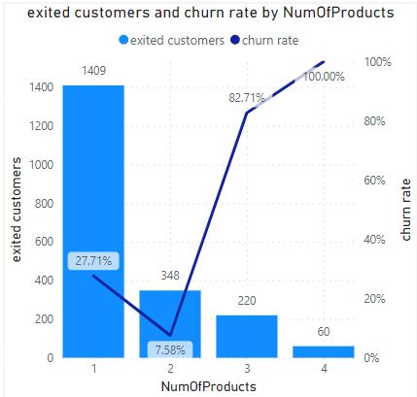
Critical/important churn rates of different kind of customers

Slide 9
Key points
The critical/important churn rates has very high churn rates in few kind of customers.
The customers who have aged 51+ years old have churn rate of 44.65%.
The customers with account balance greater than or equal to 225001 have churn rate of 100%.
The customers who are using 3 and 4 products have churn rates 82.71% and 100% respectively.

Slide 10
Suggestions
For the customers who have aged 51+ years old we can introduce senior citizens benefits plan or we can do similar activities to decrease the churn rate.
For the customers with account balance greater than or equal to 225001 we can suggest various investment plan with competitive rates for their funds to help them have future secured financial status for better living to decrease the churn rate.
For The customers who are using 3 or more products we can provide considerable rates of discounts by encouraging them use more products for better prices to decrease the churn rate.

Slide 11
Meeting conclusion
In this meeting we got know that we have overall churn rate of 20.37% and understood that 1/5 of customers were leaving the bank.
We got know that we have overall 48.49% inactive customers and understood that approximately 50% of customers we inactive due some reason.
We got know that we have increasing trend of churn rate over a time period.
We got know about top 3 common characteristics among exited customers and discussed ideas and suggestions regarding them to prevent further customers exits and to retain customers, resolve issues and to find root cause of customers exits.
We got know about critical churn rate in few kind of customers and understood the importance to retain them and discussed ideas and suggestions regarding them to decrease those high churn rates in future.

Slide 12
Thank you

